Slide 1
Building a Generative AI Model for Contextual Question Answering
Leveraging DeepSeek API and Database for Accurate, Domain-Specific Answers

Slide 2
Problem Statement
Objective:
• Develop a generative AI model to answer user questions.
• Answers must be generated exclusively from a predefined dataset.
Constraints:
• No external data sources.
• Dataset stored in a database.
• Use DeepSeek API for search and retrieval.

Slide 3
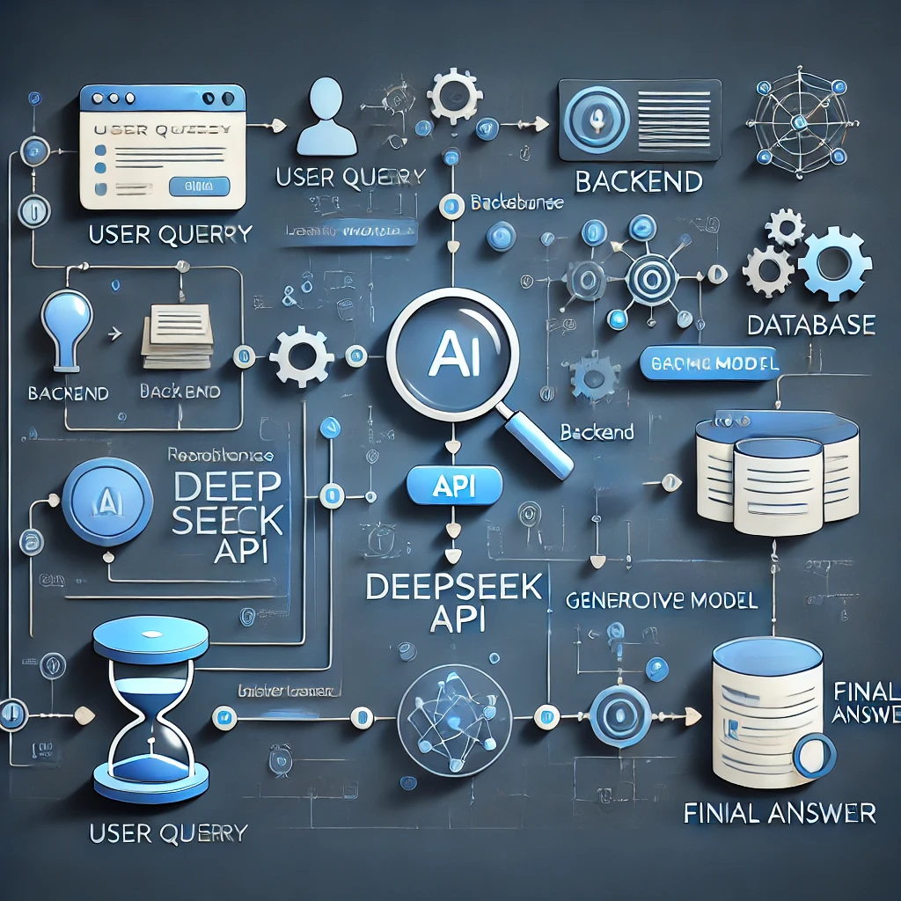
System Overview
High-Level Architecture:
User Query → Backend → DeepSeek API → Database → Generative Model → Answer
Key Components:
1) Database (PostgreSQL, MongoDB, Pinecone)
2) DeepSeek API (for search and retrieval)
3) Generative AI Model (GPT-4, LLaMA)
4) Backend and Frontend

Slide 4
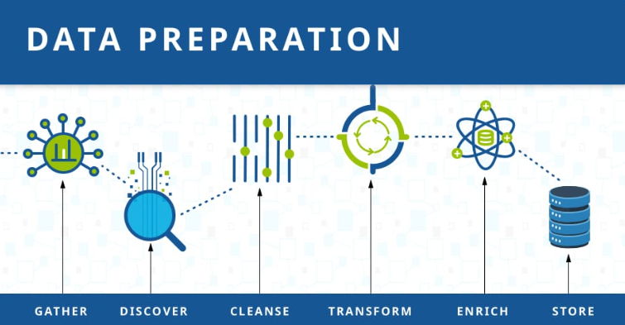
Dataset Preparation
Steps:
• Collect and clean the dataset.
• Structure the data for efficient retrieval.
• Store in a database (SQL/NoSQL/Vector DB).
Dataset:
FAQs,
product manuals,
or domain-specific documents.

Slide 5
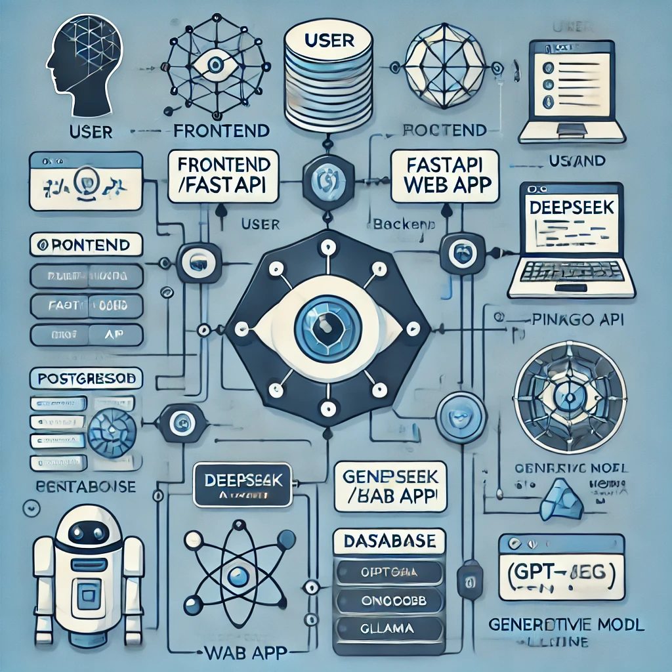
Search and Retrieval
DeepSeek API Integration:
• Semantic search for relevant data.
• Query: 'What is the capital of France?'
• Retrieval: 'France's capital is Paris.'
Database:
• Use vector databases for efficient similarity search.

Slide 6
Generative Model
Model Selection:
• Pre-trained models: GPT-4, LLaMA, Mistral.
• Fine-tuning (optional) for domain-specific performance.
Answer Generation:
• Input: Retrieved data + User query.
• Output: Coherent and accurate answer.

Slide 7
System Architecture
Diagram:
User → Frontend → Backend → DeepSeek API → Database → Generative Model → User
Components:
• Frontend: User interface (chatbot or web app)
• Backend: Flask/FastAPI/Django
• Database: PostgreSQL, MongoDB, Pinecone
• Generative Model: GPT-4 or similar

Slide 8
Workflow Example
Step-by-Step:
1. User Query: 'What is the capital of France?'
2. DeepSeek API searches the database.
3. Retrieves: 'France's capital is Paris.'
4. Generative Model synthesizes the answer.
5. Response: 'The capital of France is Paris.'

Slide 9
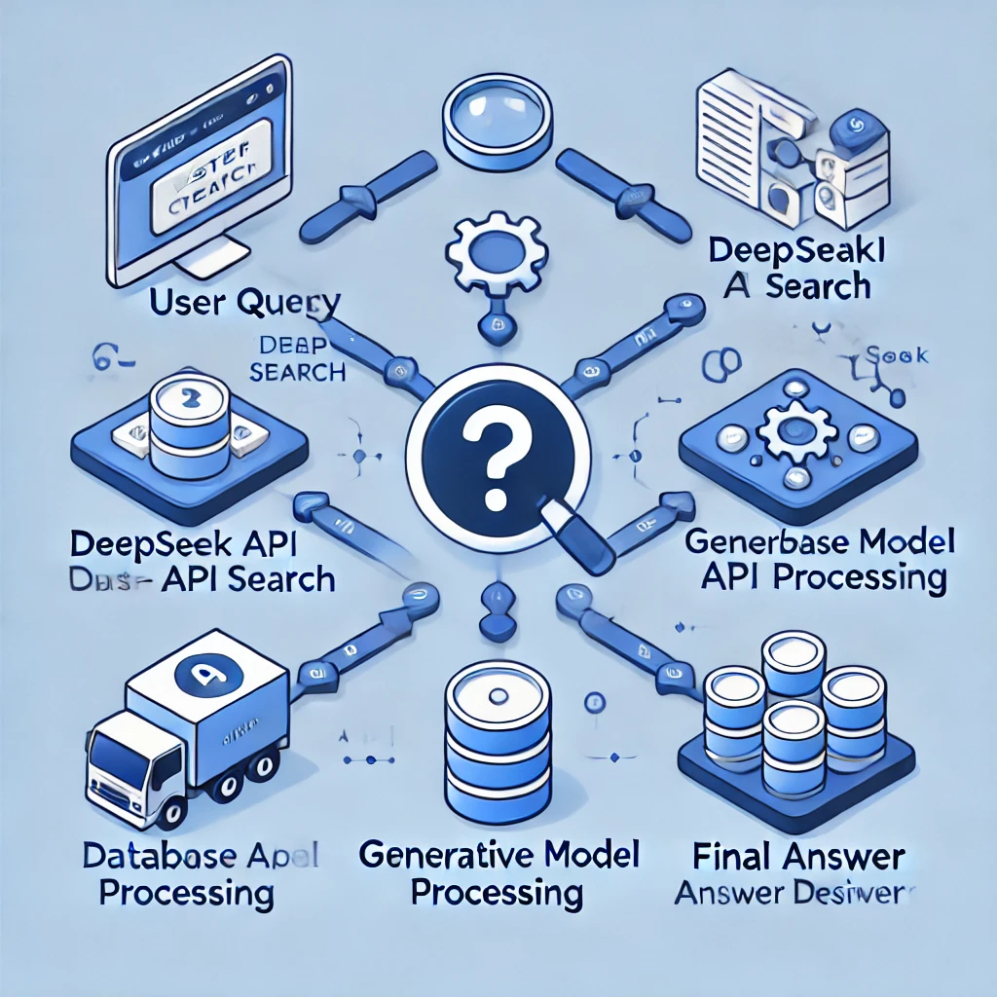
Evaluation and Testing
Metrics:
• Accuracy: Correctness of answers.
• Latency: Response time.
• User Feedback: Improve model and dataset.
Testing:
• Test with diverse queries.
• Monitor performance in real-time.

Slide 10
Tools and Technologies
• Database: PostgreSQL, MongoDB, Pinecone
• Search API: DeepSeek API
• Generative Model: GPT-4, LLaMA, Mistral
• Backend: Flask, FastAPI, Django
• Frontend: React, Angular, or chatbot framework
• Cloud: AWS, GCP, Azure

Slide 11
Conclusion
Summary:
Built a generative AI model for domain-specific question answering.
Utilized DeepSeek API and database for accurate, context-aware answers.
Provides reliable, data-driven responses without external sources.

